Slide 1




Methodological comparison of macroseismic magnitude estimates for events along the French-Italian border
Provost L., Scotti O., Antonucci A., Rovida A.

Slide 2
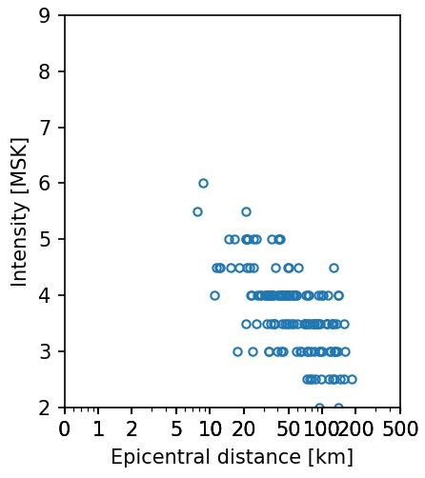
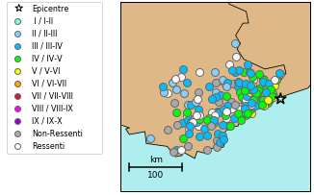
Macroseismic Intensity data
21/04/1995 Mw=4.4 (Si-Hex)
V → Strong : felt by most people, fall of small objects, visible damage to masonry structures
II → Hardly felt: felt only by individuals at rest

Slide 3
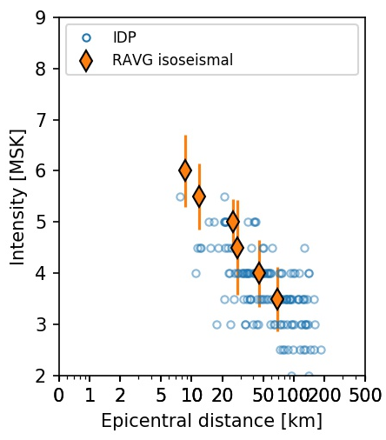
Macroseismic Intensity data
21/04/1995 Mw=4.4 (Si-Hex)
Intensity prediction equation (IPE) : I=f(M, distance)

Slide 4
Questions
Different methodologies to estimate historical earthquake parameters from macroseismic intensity data
➔ How do 2 different methodologies (Boxer/Italy –INGV and QUake-MD/France-IRSN) impact magnitude estimates?
→ Compare estimated magnitudes using the same macroseismic intensity data set

Slide 5
Plan of presentation
Macroseismic data set used for the comparison exercise
BOXER and QUAKE-MD methodologies
Comparing QUAKE-MD/BOXER magnitude estimates
Conclusions and perspectives
Notes:
Présenter Quake-MD

Slide 6
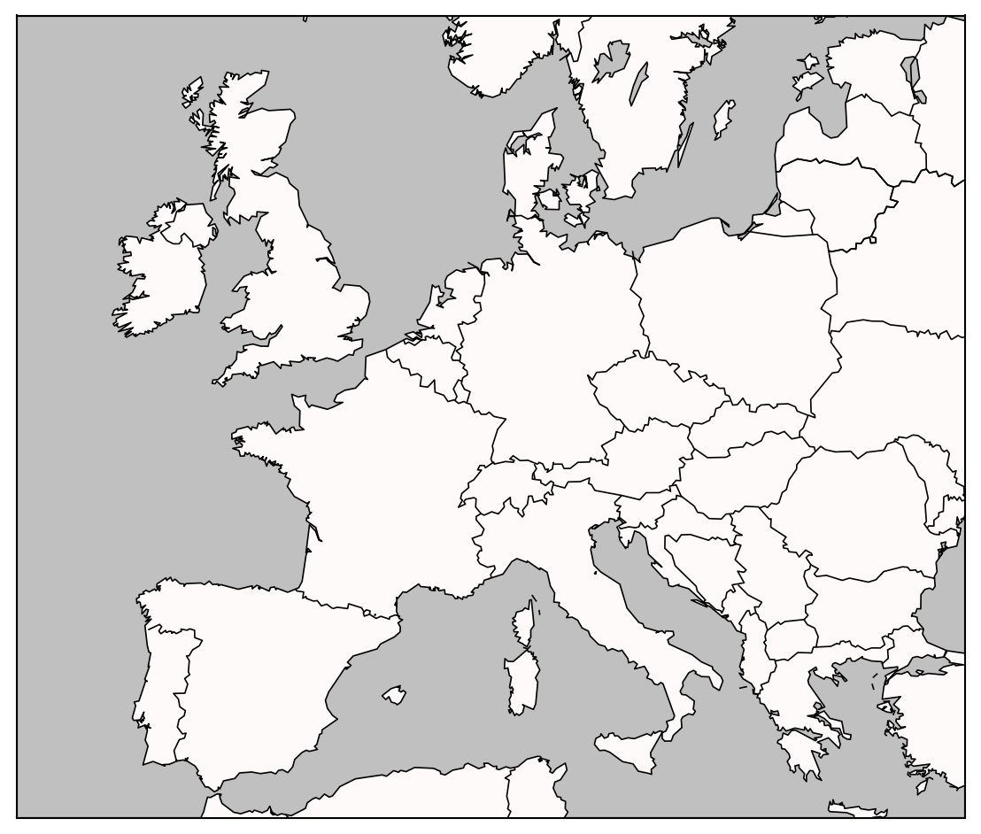
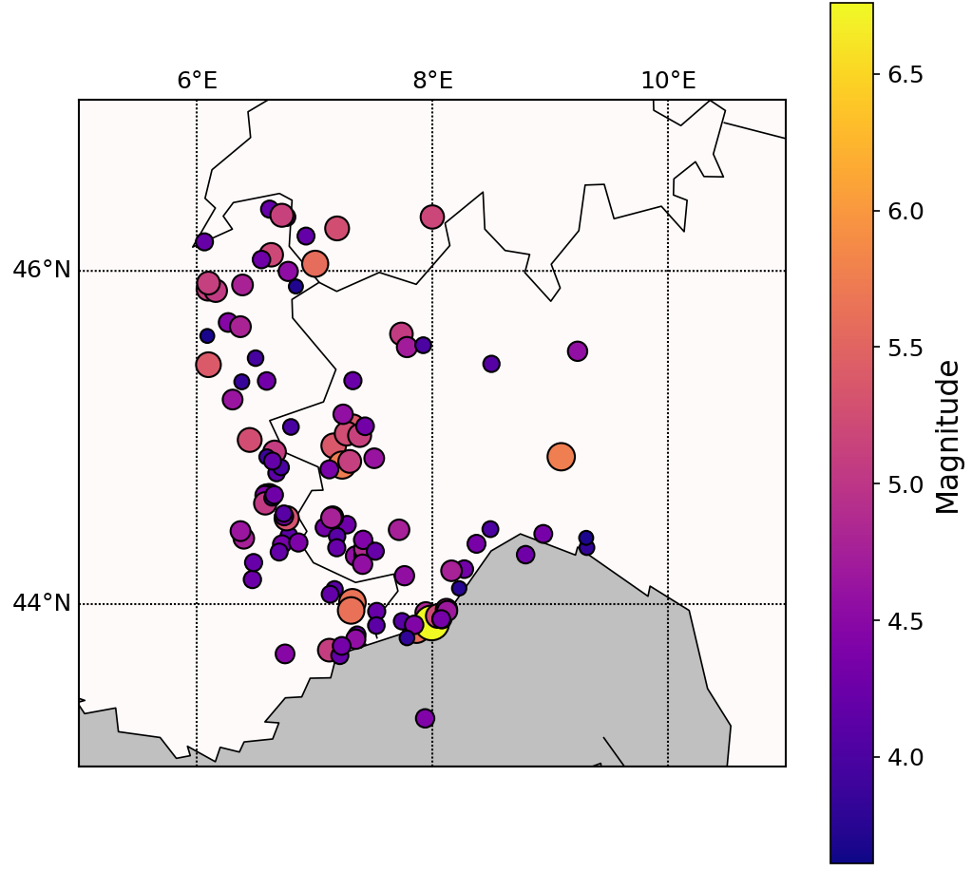
1. Macroseismic data set used for the comparison exercise
117 earthquakes along the French Italian border:
More than 3 intensity classes
2 intensity classes and more than 5 macroseismic data point
Macroseismic magnitudes are estimated by applying QUAKE-MD and BOXER to Sisfrance macroseismic intensity data points

Slide 7
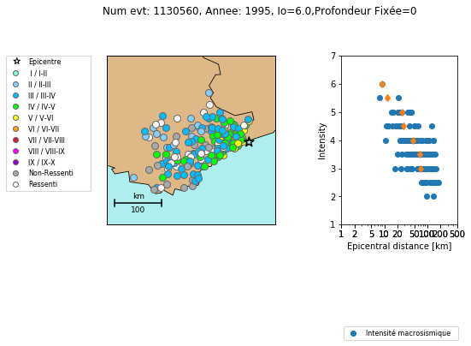
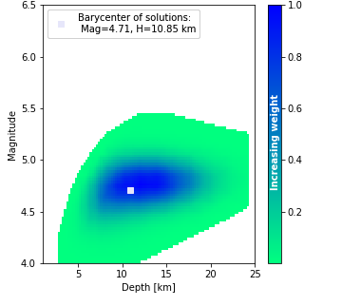


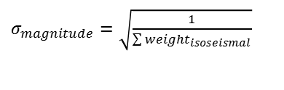
2. Boxer and QUake-MD methodologies
Boxer (INGV)
QUake-MD (IRSN)
Boxer calibration events
$M(I)=a(I)+b(I)I_{0}+c{(I)\left[log⁡(πD_{epi})\right]}^{2}$
Depth implicitly taken into account
Magnitude are computed for each intensity level
Quantified uncertainties =f(#data)
QUake-MD calibration events
$I=C_{1}+C_{2}M+βlog⁡(D_{hypo})$
Depth explicitly taken into account
Magnitude and depth are computed to fit the macroseismic field
Uncertainty on I₀ taken into account
Quantified uncertainties =f( data quality, numerous IPE)
M_{Boxer}
Weighted mean
Intensity
$σ_{magnitude}=\sqrt{\frac{1}{\sum{{weight}_{isoseismal}}}}$
M_{Quake-MD}
Barycenter of the space of solutions
Intensity
Hypocentral distance

Slide 8
3. Comparing QUAKE-MD/BOXER magnitude estimates
First comparison : same epicenter (I₀ and xy), Boxer’s epicenter
Second comparison : for Boxer, Boxer’s epicenter, for QUake-MD SisFrance epicenter

Slide 9
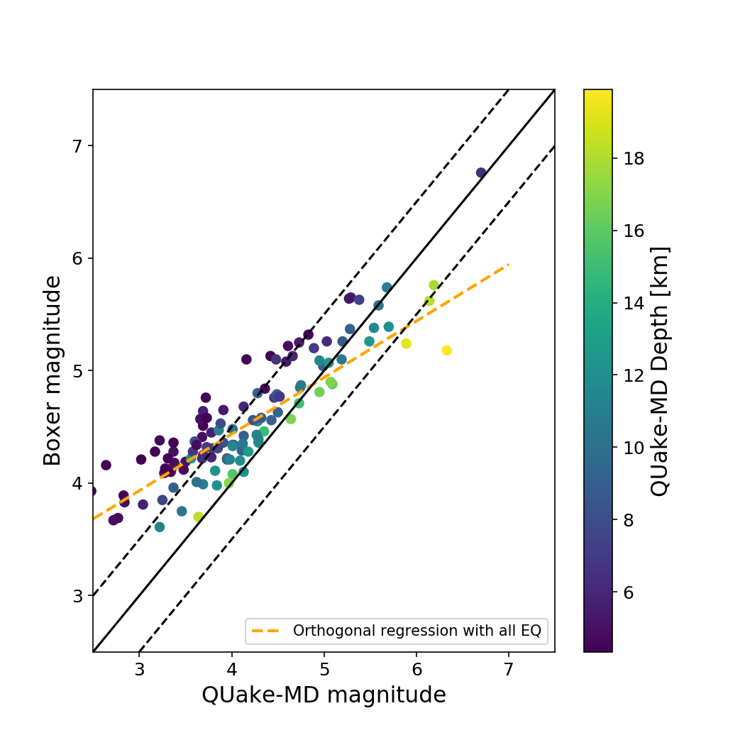
3. Comparing QUAKE-MD/BOXER magnitude estimates
Same epicenter (Boxer epicenter)

Slide 10
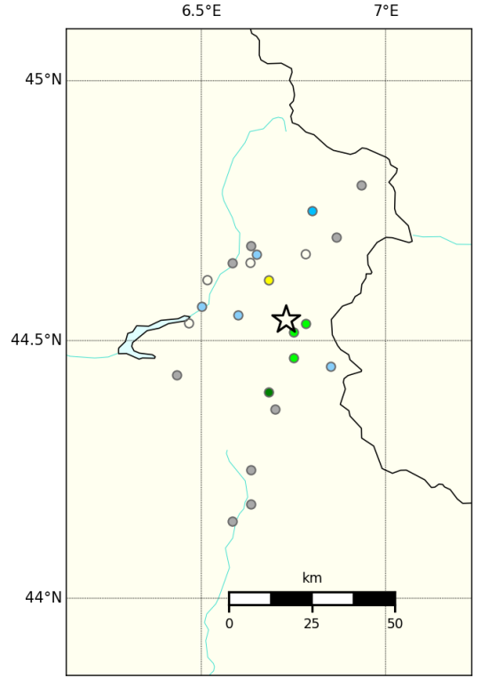

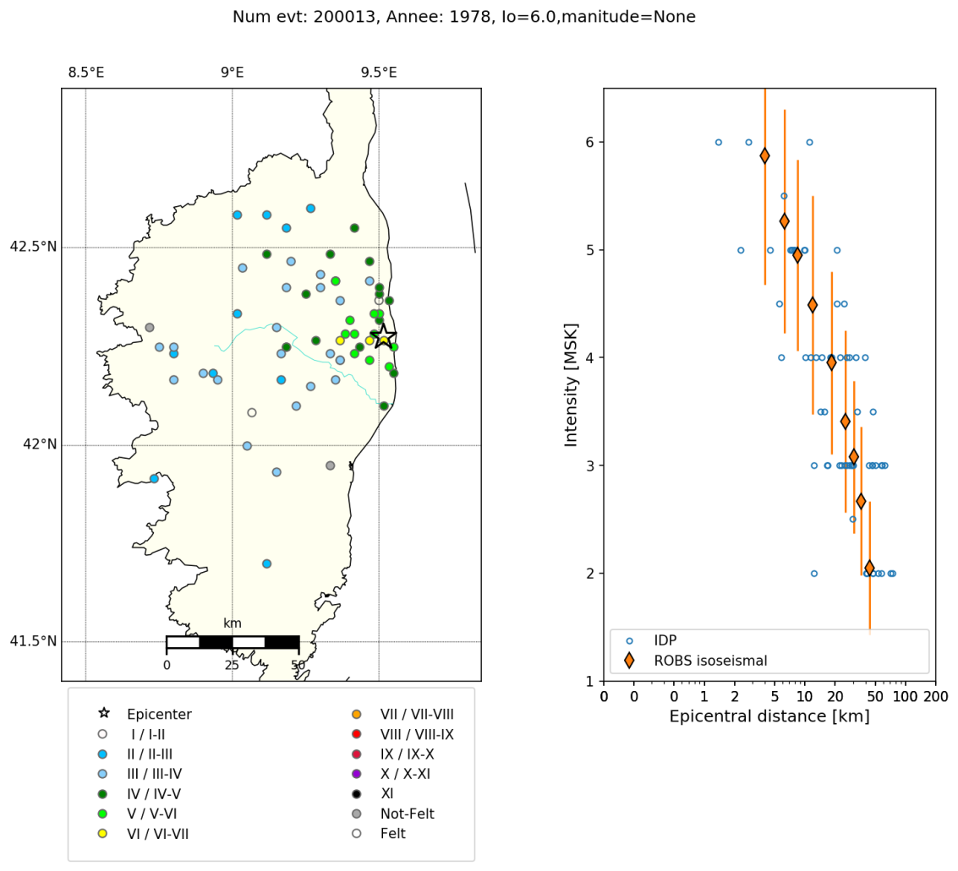

3. Comparing QUAKE-MD/BOXER magnitude estimates
Sparse data ➔ rapid decrease of intensity data
Rapid decrease of intensity data
QUake-MD:
Rapid decrease of intensity data ➔ Shallow depth
Shallow depth ➔ small magnitude

Slide 11
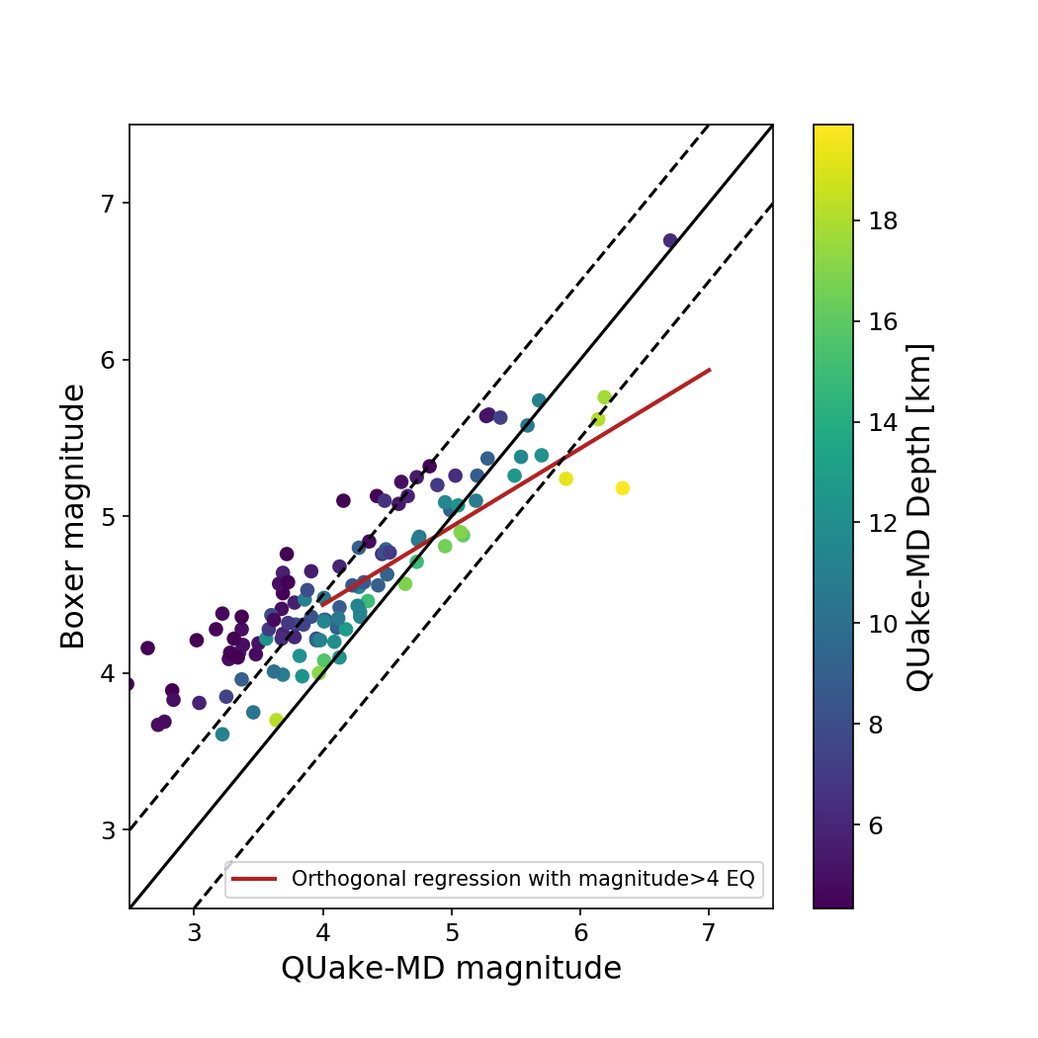
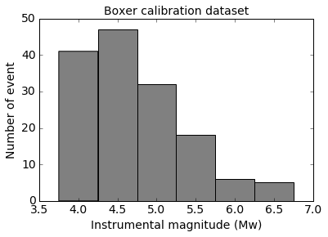
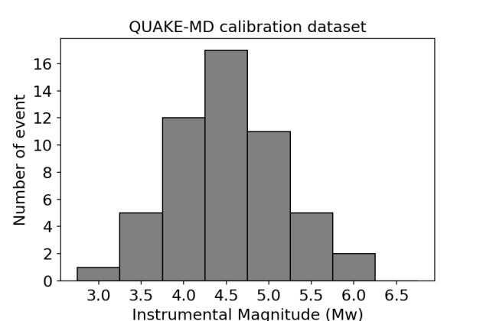
3. Comparing QUAKE-MD/BOXER magnitude estimates
Same epicenter (Boxer epicenter)

Slide 12
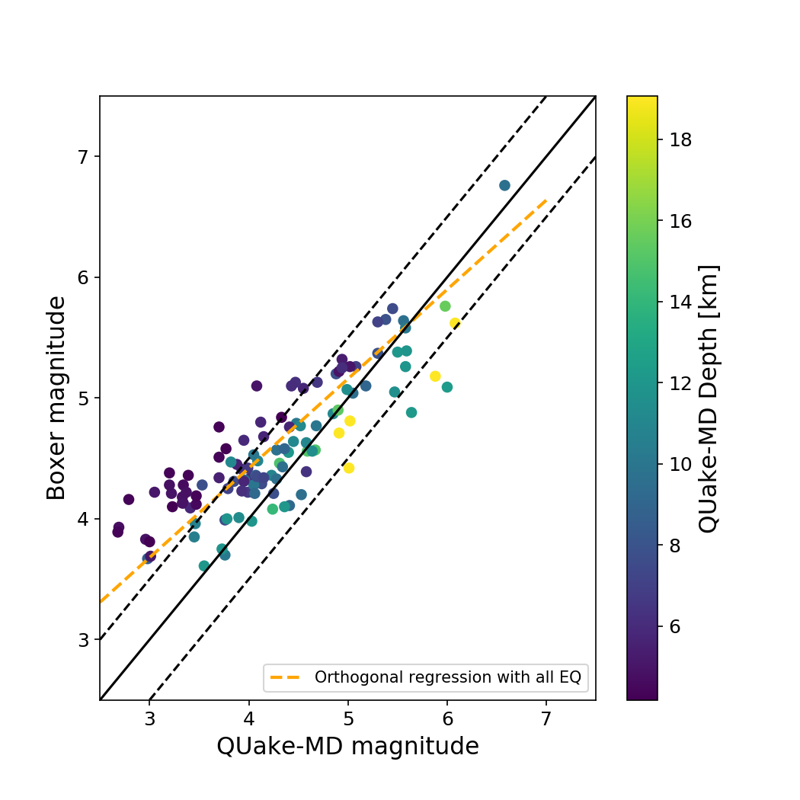
3. Comparing QUAKE-MD/BOXER magnitude estimates with SisFrance epicenter for Quake-MD
Boxer → Boxer epicenter
Quake-MD → SisFrance epicenter

Slide 13
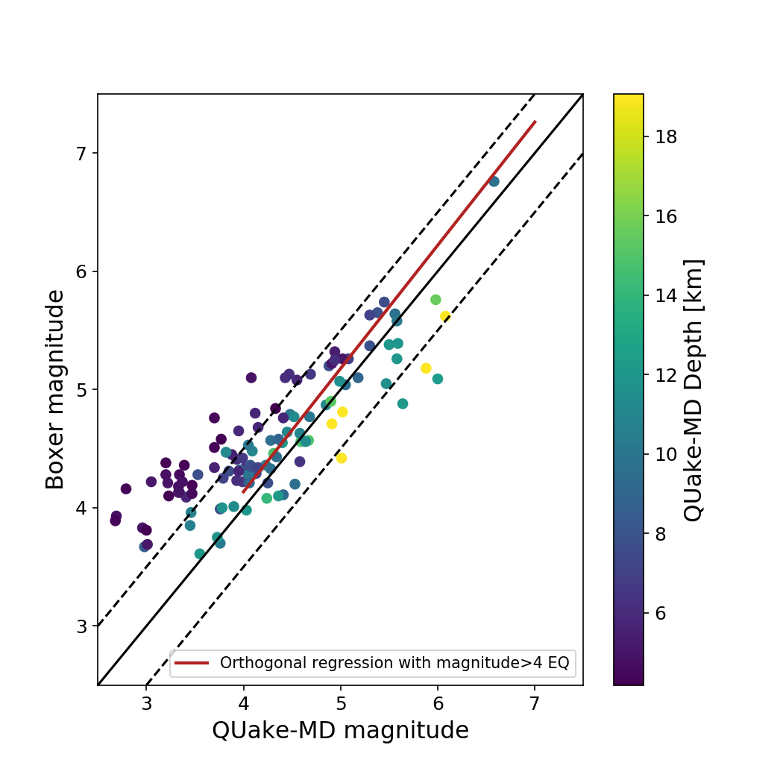
3. Comparing QUAKE-MD/BOXER magnitude estimates with SisFrance epicenter for Quake-MD
Boxer → Boxer epicenter
Quake-MD → SisFrance epicenter

Slide 14
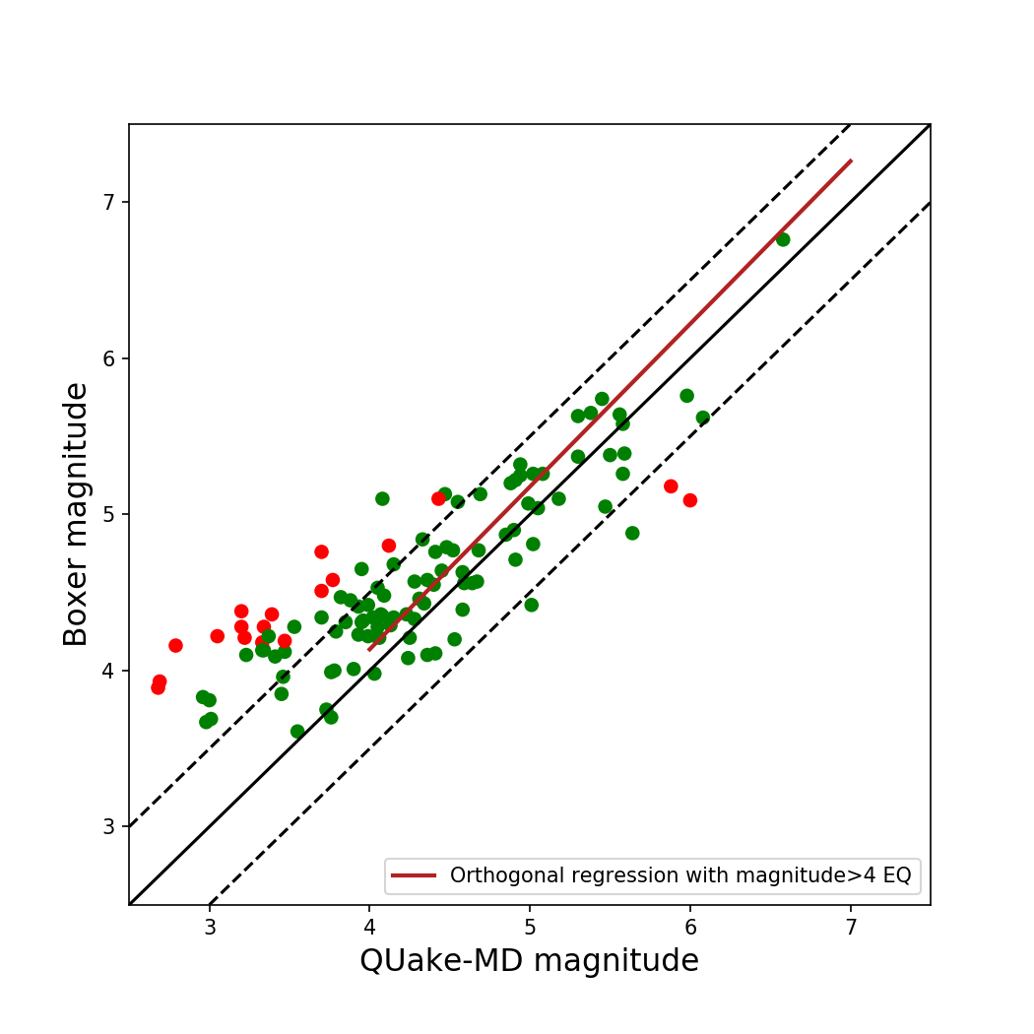
3. Comparing QUAKE-MD/BOXER magnitude estimates with SisFrance epicenter for Quake-MD
Magnitude estimates + uncertainties intersect
Magnitude estimates + uncertainties don’t intersect

Slide 15
Conclusions
Comparing QUAKE-MD/BOXER magnitude estimates
Good agreement between the two magnitude estimates (with the uncertainties)
No bias between the two magnitude estimates
Epicenter (xy + I0): part of the methodologies
NB IPEs should not be extrapolated beyond their limits of applicability

