Slide 1
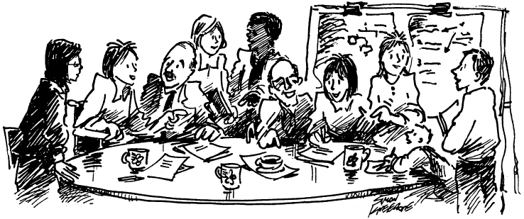
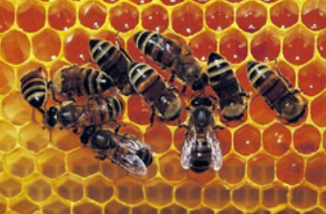
Olivier Laurent¹, Yara Carrejo Gironza², Sophie Ancelet¹, Olivier Armant¹, Denis Bard³, Katia Baumgartner⁴, Sylvie Bortoli⁵, Céline Boudet⁶, Philippe Chamaret⁷, Michel Chartier^{1,} Stéphanie Cormier⁸, Arthur David⁹, Hélène Desqueyroux ¹⁰, Mariette Gerber¹¹, Rodolphe Gilbin¹, Sonia Grimbuhler¹², Stéphane‎ Grison¹, Lionel Larqué¹³, Dominique Laurier¹, Christian Mougin¹⁴, Laurence Payrastre¹⁵, Alain Rannou¹, Pascale Scanff¹, Arnaud Vanzemberg¹, Simon Schraub¹⁶, Sylvie Supervil¹, Eric Thybaud⁶, Brigitte Trousse¹⁷, Sylvie Charron¹
The LILAS project: analysis of applying participatory approaches such as Living Labs to research on multiple environmental exposures to ionizing radiation, other stressors and chronic risks
1. IRSN; 2. IRSET; 3. SFSE; 4. FNE; 5. INSERM UMRS 1124 - Université de Paris; 6. Ineris; 7. Institut Ecocitoyen pour la Connaissance des Pollutions; 8. CPIE des Pays de l'Aisne, pour l'UNCPIE; 9. Université de Rennes, EHESP, Inserm, IRSET - UMR_S 1085; 10. ADEME; 11. Experte scientifique auprès de l’ANCCLI; 12. INRAE, UMR ITAP, (INRAE/Institut Agro); 13. ALLISS; 14. INRAE, UMR ECOSYS, Pôle Ecotoxicologie; 15. INRAE, UMR 1331, TOXALIM, INRAE/ENVT/EI Purpan/UPS; 16. Ligue Nationale contre le cancer; 17. Inria Centre de Sophia Antipolis – Méditerranée /France Living Labs
Context
Participatory research approaches in environmental health are still rarely applied to radiation research. Opportunities for greater implication of the civil society and related challenges differ at each step of such research activities. The LILAS project aimed, as a preparatory step toward the development of participatory research projects on multiple environmental exposures to ionizing radiation and other stressors, to :
favor a mutual understanding of the main problematics and research methods in environmental health, their stakes for different actors, but also the requirements, strengths and limitations of these methods and to
identify expected benefits and points of vigilance related to stronger degrees of participation as part of environmental health research projects.
Objectives
As a preparatory step toward the co-construction of participative research projects on multiple exposures and disease risks, he LILAS project aimed to
co-construct, among institutional researchers, academics and civil society representatives, a mutual understanding of the main problematics and research methods in environmental health, their stakes for different actors, but also the requirements, strengths and limitations of these methods
identify expected benefits and points of vigilance related to stronger degrees of participation as part of such environmental health research projects.
Methods
LILAS gathered institutional researchers, academics and civil society representatives interested in multiple exposures (chemical, radiological).
Bibliographic search to identify relevant examples
5 meetings allowed to collectively identify different types of study (including environmental epidemiological studies) and reflect about the added value, limitations, and methodological principles related to the introduction of growing participation as part of such studies.
An analysis matrix was co-constructed and filled by participants, as in a « Living Lab mode » project.
Results and perspectives
For different types of studies (studies for assessment of environmental exposures, identification of their determinants, interventions on these exposures, development of sensors, quantitative risk assessment, environmental epidemiological studies, experimental research, studies on the health of ecosystems…), the matrix* lists expected benefits for several categories of stakeholders, fundamental methodological principles and practical constraints, advantages and limitations related to the use of participatory or more “classical” approaches.
LILAS has allowed, through a cross-acculturation process, to develop consolidated grounds for the co-construction of future participatory research projects on multiple environmental exposures, including ionizing radiation and chemicals. Such a community-based research projects is now being developed, in the Dunkerque area (France) : the ORRCH-IDEeS project.
*available here : https://hal-irsn.archives-ouvertes.fr/irsn-03222498
Contact : olivier.laurent@irsn.fr

